Slide 1
High-dimensional Estimation with Geometric Constraints
Plan, Y., Vershynin, R. and Yudovina, E. 2017. Information and Inference: A Journal of the IMA, 6(1), pp.1-40.
Parnian Kassraie Compressed Sensing, Sharif University of Technology, Spring 2018

Slide 2
Outline
Paper Review
Matrix Completion
Evaluation
Notes:
Outline

Slide 3
The Model
The Estimator
Upper and Lower Bounds on Estimation Error
Notes:
Colored, Beginning of Part 1

Slide 4


Semiparametric Single Index Model
$$y_{i}=f\left(\left\langle a_{i},x\right\rangle +ε_{i}\right), 1≤i≤m$$
Unknown function $f:ℝ→ℝ$
Fixed unknown signal $x∈K⊂ℝ^{n}$
i.i.d random variables $a_{i}\sim N\left(0,I_{n}\right)$
Star-Shaped: $λK⊆K, 0≤λ≤1$
Model & Assumptions
Notes:
Model+ Linear Estimation with Projection (until 1.3)

Slide 5

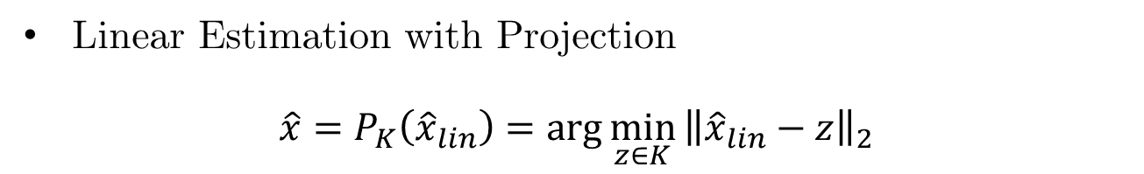
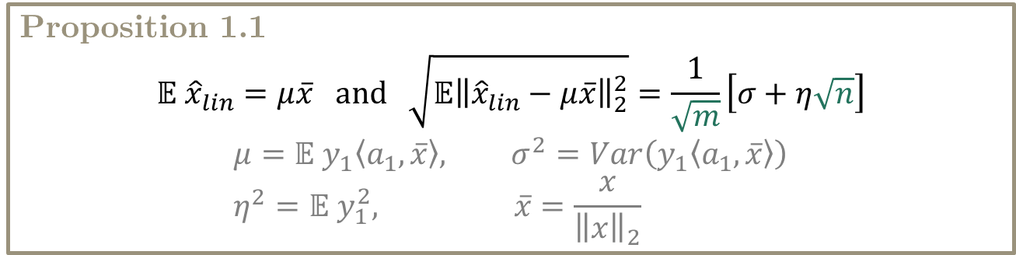
Linear Estimation
$${\hat{x}}_{lin}≔\frac{1}{m}\sum_{i=1}^{m}{y_{i}a_{i}}$$
Accurate estimation for m=O(n)
Proposition 1.1
$$𝔼{ \hat{x}}_{lin}=μ\overline{x} and \sqrt{𝔼{\left\|{\hat{x}}_{lin}−μ\overline{x}\right\|}_{2}^{2}}=\frac{1}{\sqrt{m}}\left[σ+η\sqrt{n}\right]$$
$$μ=𝔼 y_{1}\left\langle a_{1},\overline{x}\right\rangle , σ^{2}=Var\left(y_{1}\left\langle a_{1},\overline{x}\right\rangle \right) \\ η^{2}=𝔼 y_{1}^{2}, \overline{x}=\frac{x}{{\left\|x\right\|}_{2}}$$
Linear Estimation with Projection
$$\hat{x}=P_{K}\left({\hat{x}}_{lin}\right)=\arg{\min_{z∈K}}{\left\|{\hat{x}}_{lin}−z\right\|}_{2}$$
Estimator

Slide 6
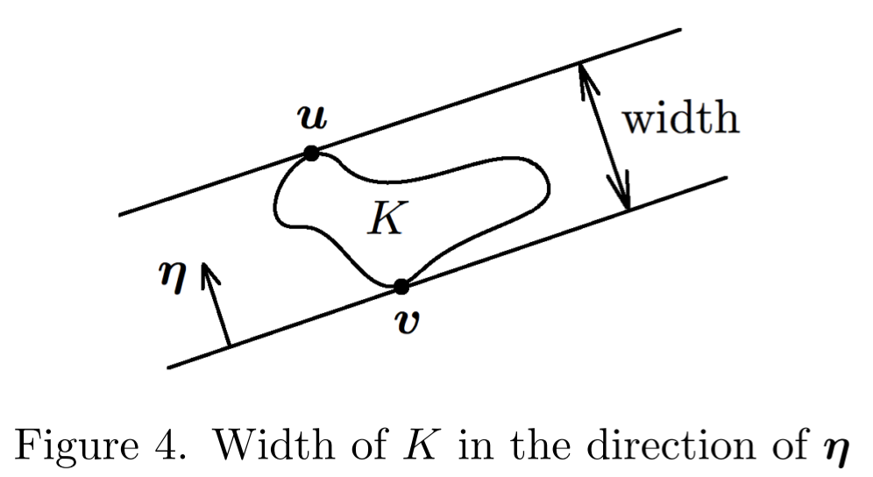
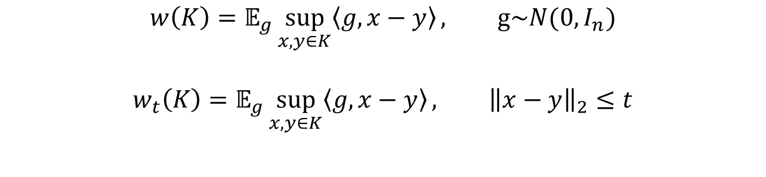
Mean Width
$$w\left(K\right)=𝔼_{g}\sup_{x,y∈K}\left\langle g,x−y\right\rangle , g\sim N(0,I_{n})$$
$$w_{t}\left(K\right)=𝔼_{g}\sup_{x,y∈K}\left\langle g,x−y\right\rangle , {\left\|x−y\right\|}_{2}≤t$$
Local Mean Width
Geometric Upper Error Bound
Notes:
Mean width + Couple of Examples

Slide 7
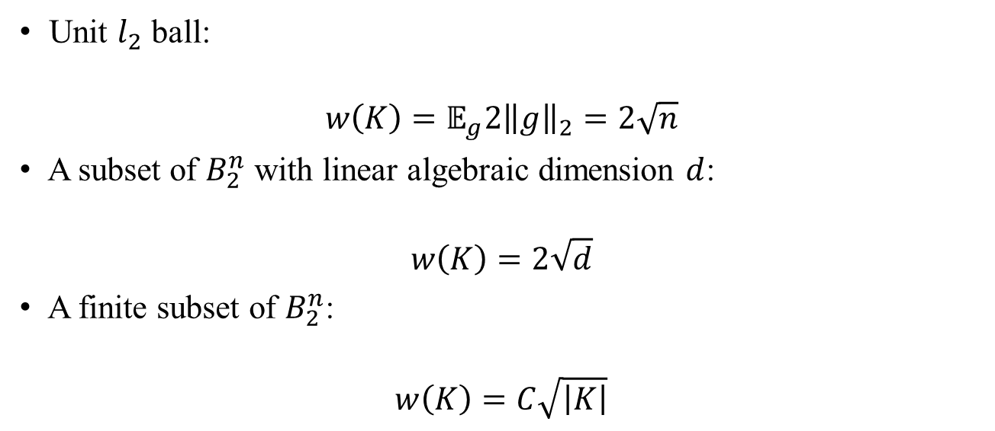
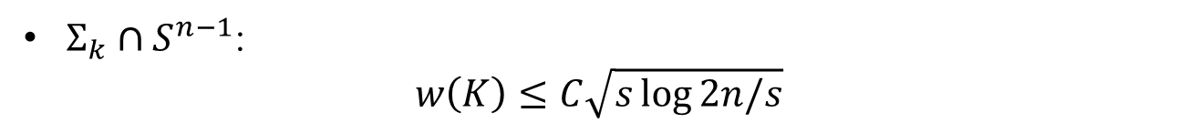
Mean Width
Unit $l_{2}$ ball:
$$w\left(K\right)=𝔼_{g}2{\left\|g\right\|}_{2}=2\sqrt{n}$$
A subset of $B_{2}^{n}$ with linear algebraic dimension $d$:
$$w\left(K\right)=2\sqrt{d}$$
A finite subset of $B_{2}^{n}$:
$$w\left(K\right)=C\sqrt{\left|K\right|}$$
$Σ_{k}∩S^{n−1}$:
$$w\left(K\right)≤C\sqrt{s\log{2n/s}}$$
Geometric Upper Error Bound
Notes:
Mean width + Couple of Examples

Slide 8
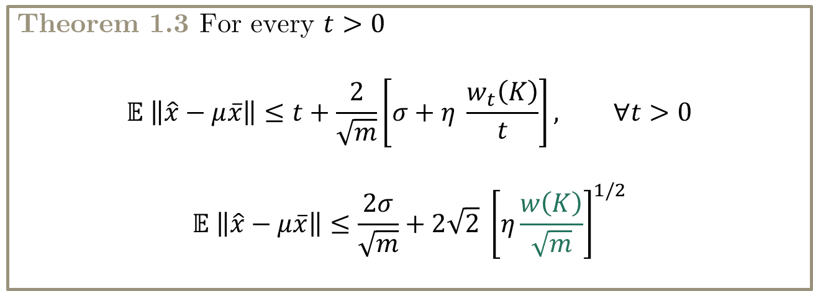
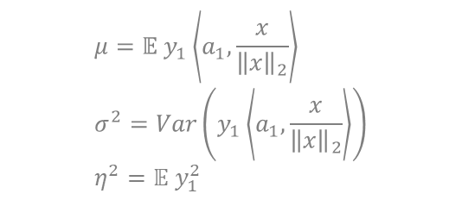

Upper Error Bound for $\hat{x}$
Theorem 1.3 For every $t>0$
$$𝔼 \left\|\hat{x}−μ\overline{x}\right\|≤t+\frac{2}{\sqrt{m}}\left[σ+η \frac{w_{t}\left(K\right)}{t}\right], ∀t>0$$
$$𝔼 \left\|\hat{x}−μ\overline{x}\right\|≤\frac{2σ}{\sqrt{m}}+2\sqrt{2} {\left[η\frac{w\left(K\right)}{\sqrt{m}}\right]}^{1/2}$$
$$μ=𝔼 y_{1}\left\langle a_{1},\frac{x}{{\left\|x\right\|}_{2}}\right\rangle \\ σ^{2}=Var\left(y_{1}\left\langle a_{1},\frac{x}{{\left\|x\right\|}_{2}}\right\rangle \right) \\ η^{2}=𝔼 y_{1}^{2}$$
Geometric Upper Error Bound
Notes:
Theorem 1.3 + Compare with linear estimation

Slide 9
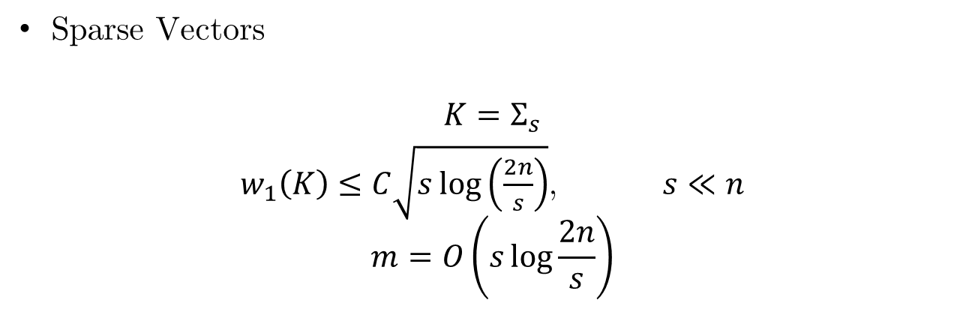
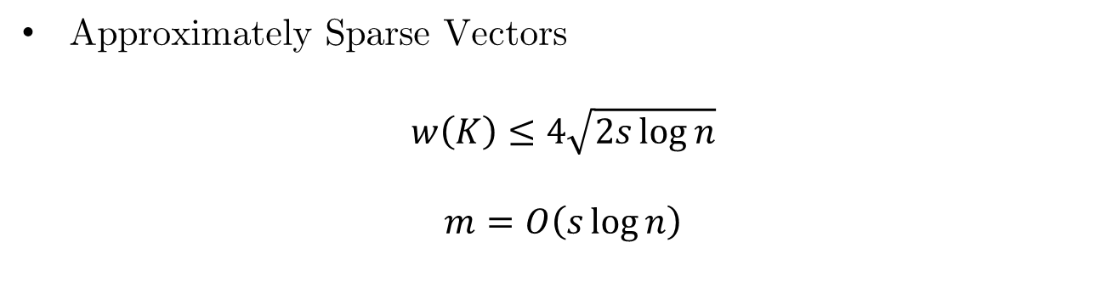
Commonly Used Feasible Sets
Sparse Vectors
$$K=Σ_{s}$$
$w_{1}\left(K\right)≤C\sqrt{s\log\left(\frac{2n}{s}\right)}$, $s≪n$
$$m=O\left(s\log{\frac{2n}{s}}\right)$$
Approximately Sparse Vectors
$$w\left(K\right)≤4\sqrt{2s\log{n}}$$
$$m=O\left(s\log{n}\right)$$
Geometric Upper Error Bound
Notes:
Examples of Feasible sets -> Section 2: 2.2, 2.4, 2.6 ( + Maybe 2.1 and 2.5)

Slide 10
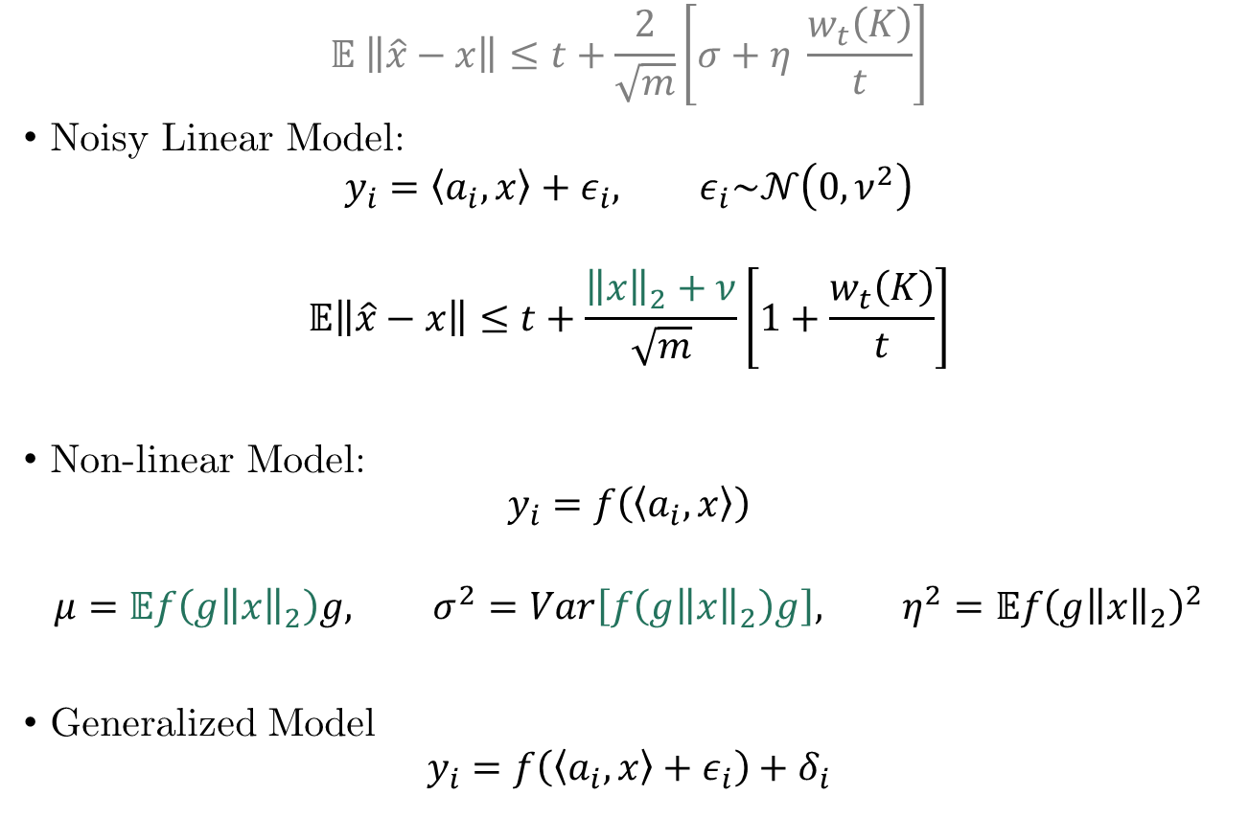
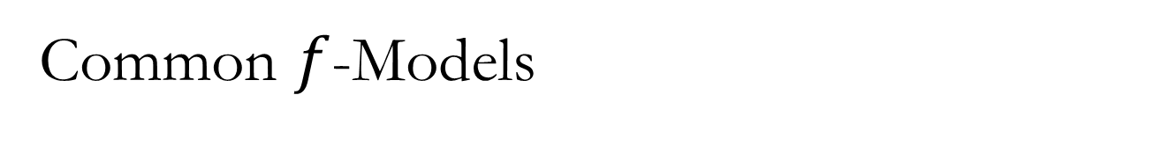


Common $f$-Models
$$μ=𝔼 y_{1}\left\langle a_{1},\frac{x}{{\left\|x\right\|}_{2}}\right\rangle \\ σ^{2}=Var\left(y_{1}\left\langle a_{1},\frac{x}{{\left\|x\right\|}_{2}}\right\rangle \right) \\ η^{2}=𝔼 y_{1}^{2}$$
$$𝔼 \left\|\hat{x}−x\right\|≤t+\frac{2}{\sqrt{m}}\left[σ+η \frac{w_{t}\left(K\right)}{t}\right]$$
Noisy Linear Model:
$$y_{i}=\left\langle a_{i},x\right\rangle +ε_{i}, ε_{i}\sim 𝒩\left(0,ν^{2}\right)$$
$$𝔼\left\|\hat{x}−x\right\|≤t+\frac{{\left\|x\right\|}_{2}+ν}{\sqrt{m}}\left[1+\frac{w_{t}\left(K\right)}{t}\right]$$
Non-linear Model:
$$y_{i}=f\left(\left\langle a_{i},x\right\rangle \right)$$
$$μ=𝔼f\left(g{\left\|x\right\|}_{2}\right)g, σ^{2}=Var\left[f\left(g{\left\|x\right\|}_{2}\right)g\right], η^{2}=𝔼f{\left(g{\left\|x\right\|}_{2}\right)}^{2}$$
Generalized Model
$$y_{i}=f\left(\left\langle a_{i},x\right\rangle +ε_{i}\right)+δ_{i}$$
i.i.d.
$$g\sim N(0,1)$$
Geometric Upper Error Bound
Notes:
Examples of models: 3.1, 3.2, 3.3, 3.4 + only 1-bit compressed sensing

Slide 11
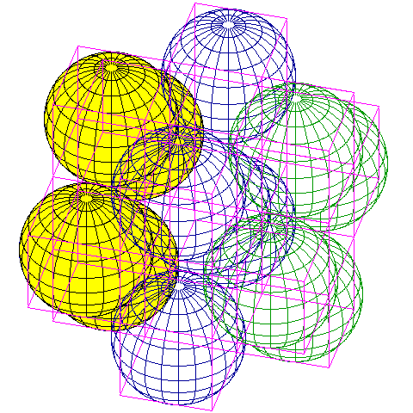


Packing Number
Packing Number of K with balls of radius t
$$χ⊂K: {\left\|v−w\right\|}_{2}≥t, ∀v,w∈χ$$
$$ℙ_{k}=\sup_{χ}{|χ|}$$
Local Packing Number
$$P_{t}=ℙ_{K∩tB_{2}^{n}}$$
Packing to Local Mean width
$$α=α\left(K\right)=\sup_{t}{\frac{w_{t}\left(K\right)}{t\sqrt{\log{P_{t}}}}}$$
With balls of radius $t/10$
Optimality
Notes:
Local Packing Number + Theorem 4.2

Slide 12



Lower Error Bound for $\hat{x}$
Noisy Linear Model
$$y_{i}=\left\langle a_{i},x\right\rangle +ε_{i}, ε_{i}\sim 𝒩\left(0,ν^{2}\right)$$
Theorem 4.2
$$δ_{∗}≔\inf_{t>0}\left\{t+\frac{ν}{\sqrt{m}}\left[1+\sqrt{\log{P_{t}}}\right]\right\}$$
$∃c>0:$
$$\sup_{x∈K}{𝔼}{\left\|\hat{x}−x\right\|}_{2}≥c\min\left(δ_{∗},diam\left(K\right)\right)$$
Any $\hat{x}$ which depends only on $y_{i},a_{i}.$
Optimality
Notes:
Local Packing Number + Theorem 4.2

Slide 13
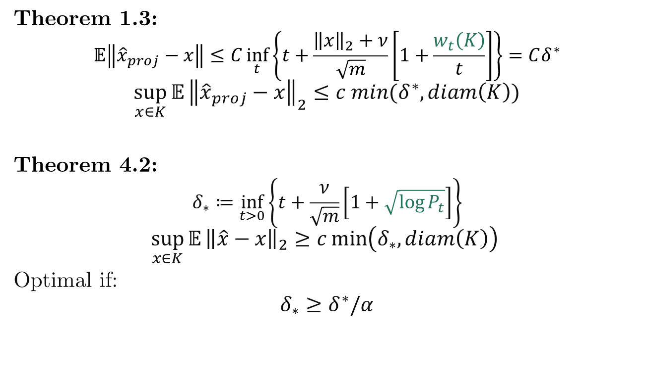
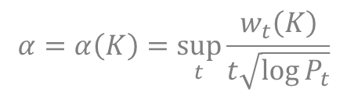
Optimality (Linear Model)
Theorem 1.3:
$$𝔼\left\|{\hat{x}}_{proj}−x\right\|≤C\inf_{t}\left\{t+\frac{{\left\|x\right\|}_{2}+ν}{\sqrt{m}}\left[1+\frac{w_{t}\left(K\right)}{t}\right]\right\}=Cδ^{∗}$$
$$\sup_{x∈K}{𝔼}{\left\|{\hat{x}}_{proj}−x\right\|}_{2}≤c min(δ^{∗},diam\left(K\right))$$
Theorem 4.2:
$$δ_{∗}≔\inf_{t>0}\left\{t+\frac{ν}{\sqrt{m}}\left[1+\sqrt{\log{P_{t}}}\right]\right\}$$
$$\sup_{x∈K}{𝔼}{\left\|\hat{x}−x\right\|}_{2}≥c\min\left(δ_{∗},diam\left(K\right)\right)$$
Optimal if:
$$δ_{∗}≥δ^{∗}/α$$
$$α=α\left(K\right)=\sup_{t}{\frac{w_{t}\left(K\right)}{t\sqrt{\log{P_{t}}}}}$$
Optimality
Notes:
Local Packing Number + Theorem 4.2

Slide 14

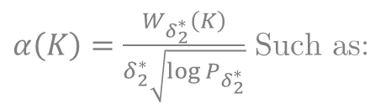
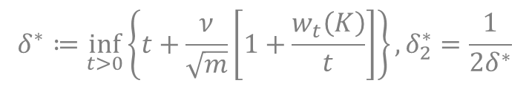
Near Optimal (Non-Linear Model)
$$y_{i}=f(\left\langle a_{i},x\right\rangle +ε_{i})$$
Noise: $ν≥c_{2}{\left\|x\right\|}_{2}$
$f(∙)$: Odd, Non-decreasing, $f\left(a∙b\right)≤f\left(a\right)∙f\left(b\right), ∀a,b>0$
K: $α\left(K\right)<C_{1}$
Then:
$${\left\|{\hat{x}}_{opt}−x\right\|}_{2}^{2}≥c\frac{c_{2}}{C_{1}}\min\left(δ^{∗},diam\left(K\right)\right)$$
$${\left\|\hat{x}−x\right\|}_{2}^{2}≤\sqrt{k} min \left(δ^{∗},diam\left(K\right)\right)$$
$α\left(K\right)=\frac{W_{δ_{2}^{∗}}\left(K\right)}{δ_{2}^{∗}\sqrt{\log{P_{δ_{2}^{∗}}}}}$ Such as:
Sparse Vectors
Low-rank Matrices
Approx. Sparse Vectors
$$δ^{∗}≔\inf_{t>0}\left\{t+\frac{ν}{\sqrt{m}}\left[1+\frac{w_{t}\left(K\right)}{t}\right]\right\}, δ_{2}^{∗}=\frac{1}{2δ^{∗}}$$
Optimality
Notes:
Nonlinear Optimality: Theorem 4.8 Corollary 4.11 – Conditions on f and K in Theorem 4.8 ( + Famous Ks)

Slide 15
Matrix Completion
Consistency of the Estimator in Convex Setting
Results & Comparisons
Notes:
Colored: Exploration and Simulation

Slide 16

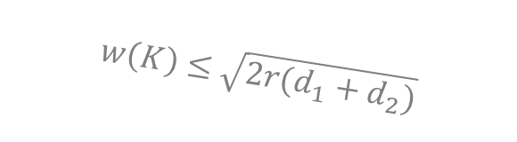
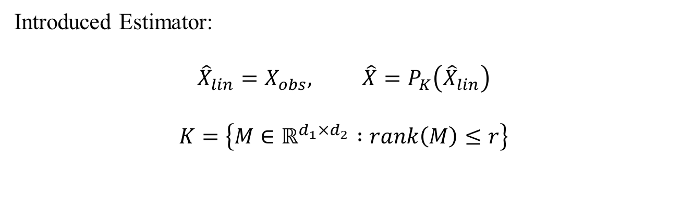
Matrix Completion Problem
Problem Formulation:
$$X∈ℝ^{d_{1}×d_{2}}, rank\left(X\right)≤r$$
$$Ω⊂\left\{1,⋯,d_{1}\right\}×\left\{1,⋯,d_{2}\right\}$$
$${\left(Δ\right)}_{ij}=1_{\left\{\left(i,j\right)∈Ω\right\}}$$
$$X_{obs}=X∘Δ$$
Introduced Estimator:
$${{\hat{X}}_{lin}=X}_{obs}, \hat{X}=P_{K}\left({\hat{X}}_{lin}\right)$$
$$K=\left\{M∈ℝ^{d_{1}×d_{2}} :rank\left(M\right)≤r\right\}$$
$$w\left(K\right)≤\sqrt{2r(d_{1}+d_{2})}$$
Definition & Assumptions
Notes:
Expand on M* Estimation from Vershynin’s paper Maybe

Slide 17





Alternative Solution
Project Iteratively Between $K,W$
$$K$$
${\left\|∙\right\|}_{∗}$ Relaxation
$$W$$
$$W=\{M∈ℝ^{d_{1}×d_{2}}, M_{Ω}=X_{Ω}\}$$
Consistency in Convex Setting

Slide 18
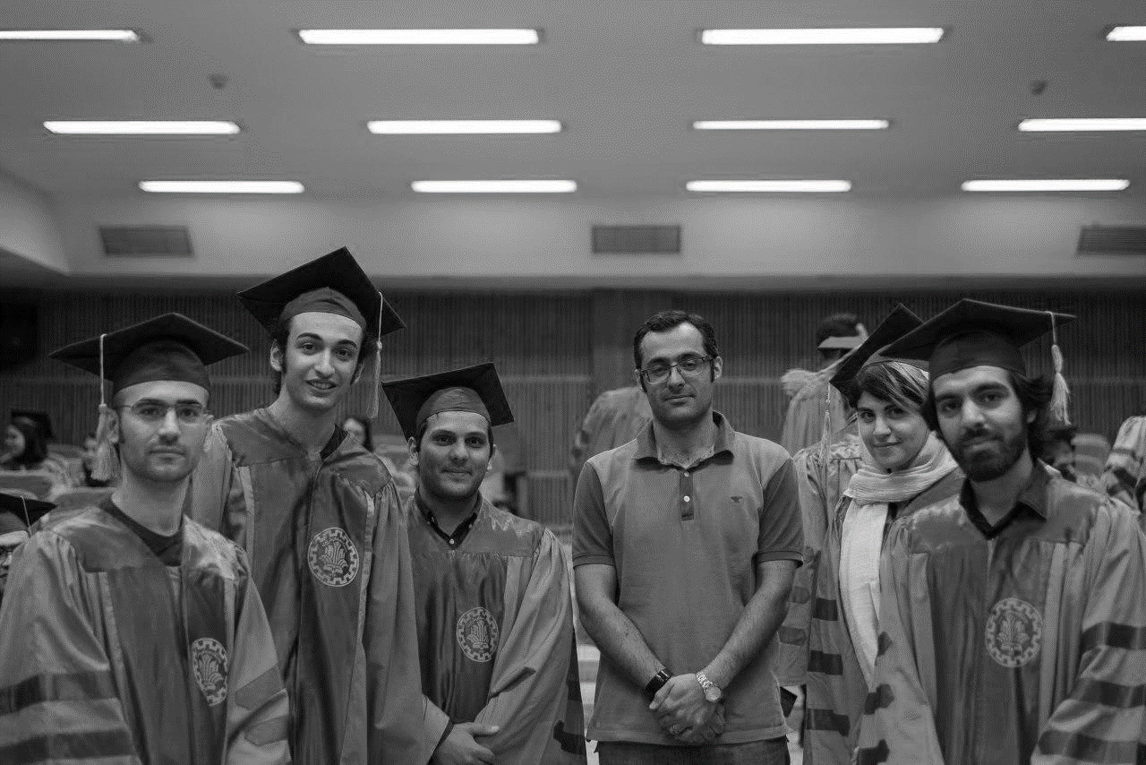
Original Image
Simulations

Slide 19
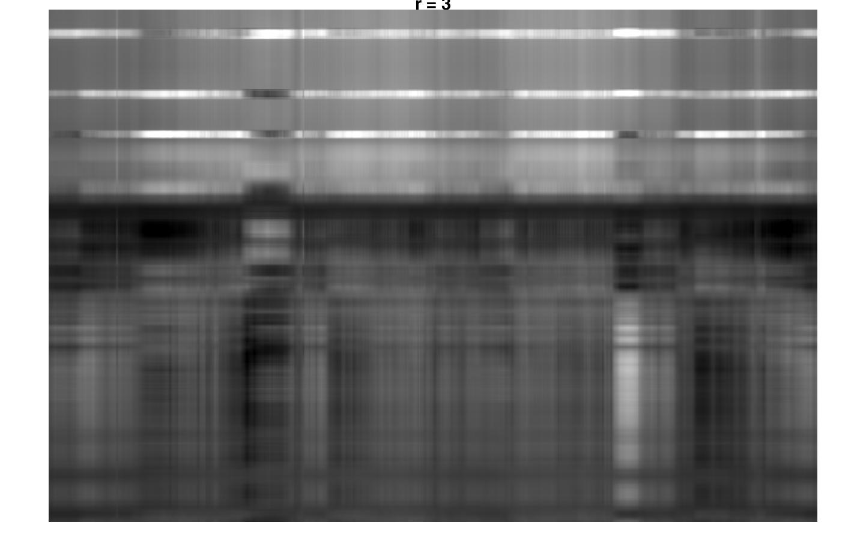
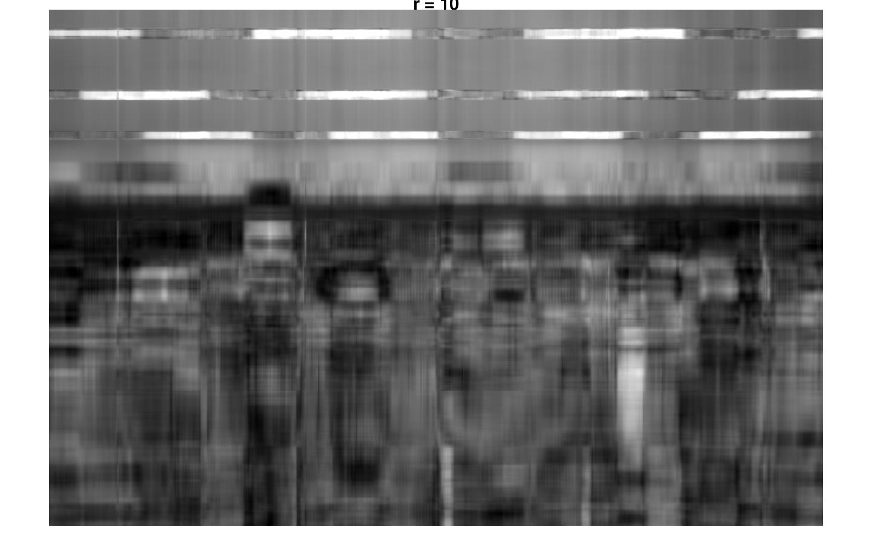
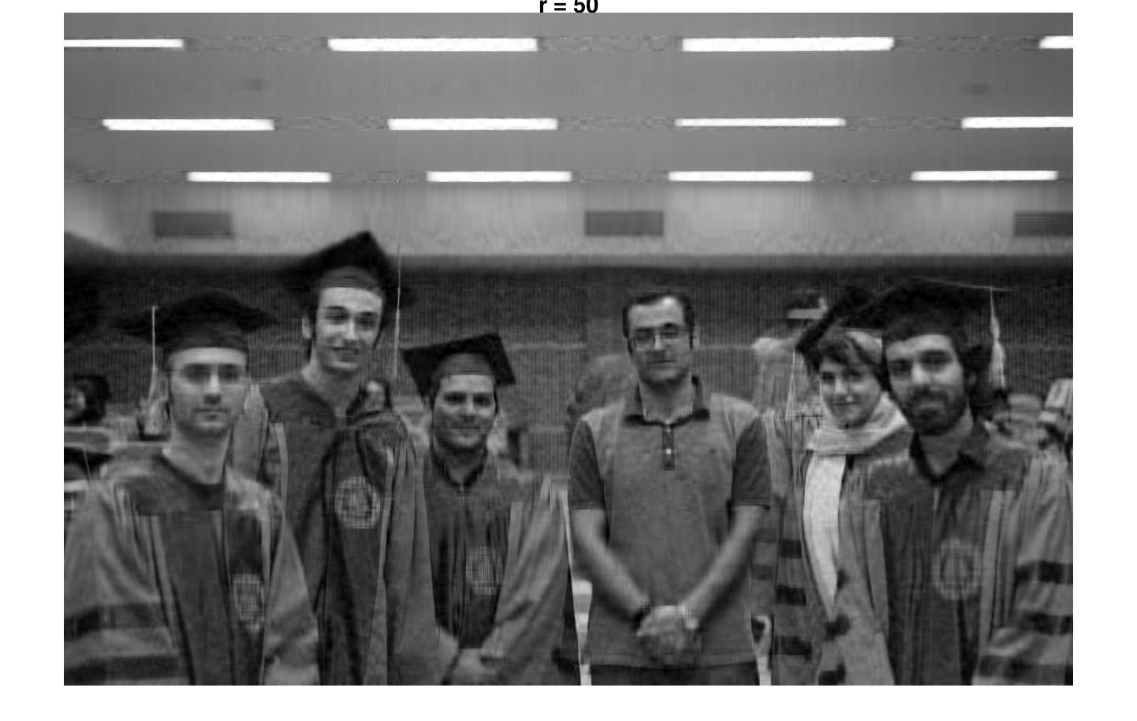

Single Iteration
Simulations

Slide 20
20 Iterations
Simulations

Slide 21
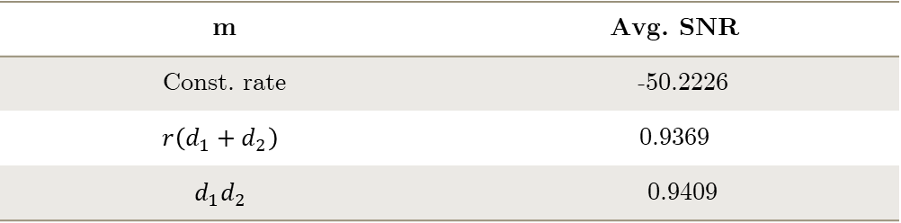
Average SNR Comparison
Order of Observations
Rank | Single Iter. | 20 Iters.
3 | -40.5565 | -41.6303
10 | 1.0223 | 1.1253
50 | 0.9369 | 0.9292
100 | 2.9225 | 2.9389
m | Avg. SNR
Const. rate | -50.2226
$$r\left(d_{1}+d_{2}\right)$$ | 0.9369
$$d_{1}d_{2}$$ | 0.9409
Results

Slide 22
Final Remarks
Bibliography
Notes:
Colored: Discussion and Comparisons and Such

Slide 23
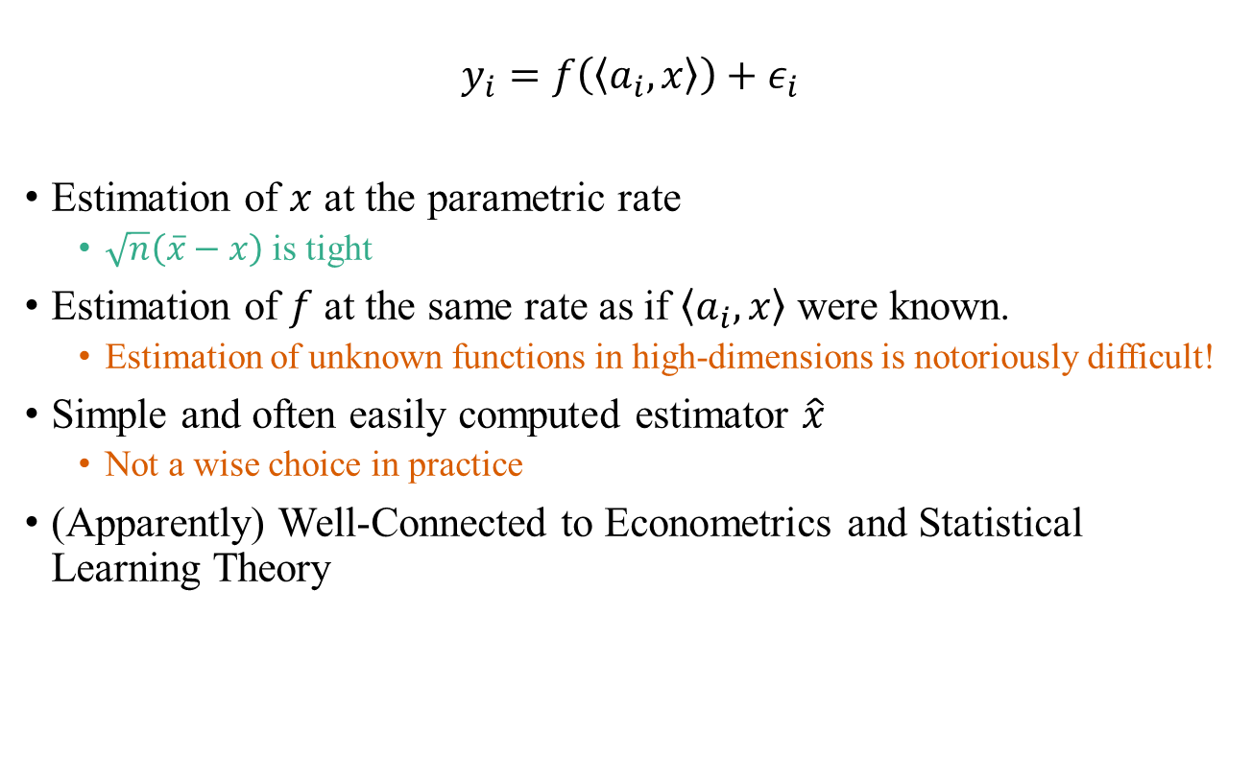
Connections and Comparisons
$$y_{i}=f\left(\left\langle a_{i},x\right\rangle \right)+ε_{i}$$
Estimation of $x$ at the parametric rate
$\sqrt{n}\left(\overline{x}−x\right)$ is tight
Estimation of $f$ at the same rate as if $\left\langle a_{i},x\right\rangle$ were known.
Estimation of unknown functions in high-dimensions is notoriously difficult!
Simple and often easily computed estimator $\hat{x}$
Not a wise choice in practice
(Apparently) Well-Connected to Econometrics and Statistical Learning Theory
Notes:
Comparisons & Connections (Probably Section 6)

Slide 24
Additional References
Giannopoulos, A. A., and V. D. Milman. "Asymptotic Convex Geometry Short Overview." Different faces of geometry. Springer, Boston, MA, 2004. 87-162.
Vershynin, Roman. "Estimation in high dimensions: a geometric perspective." Sampling theory, a renaissance. Birkhäuser, Cham, 2015. 3-66.
Plan, Yaniv, and Roman Vershynin. "Robust 1-bit compressed sensing and sparse logistic regression: A convex programming approach." IEEE Transactions on Information Theory 59.1 (2013): 482-494.
K. Alishahi, and H. Foroughmand, “Convex Optimization”, Sharif University of Technology, Spring 2018
K. Alishahi. “High-dimensional Data analysis”, Sharif University of Technology, Fall 2017.
Notes:
Bilbiography Slide

Slide 25
Thank you for your time.
Notes:
Thank you slide

